Slide 1
CORONA VIRUS ANALYSIS
Mentorness data analyst internship
Presented By: ANN Wangechi

Slide 2

CONTENT
Project Overview
Dataset Description
Queries and Results (Analysis)
Summary

Slide 3

Project 1: Corona Virus Analysis
This project is designed to test your SQL and data analysis skills in a real-world context. You are encouraged to be creative in your approach and to seek guidance and assistance as needed throughout the internship.

Slide 4

Overview
The CORONA VIRUS pandemic has had a significant impact on public health and has created an urgent need for data-driven insights to understand the spread of the virus. As a data analyst, you have been tasked with analyzing a CORONA VIRUS dataset to derive meaningful insights and present your findings

Slide 5
Dataset
Description of each column in dataset:
Province: Geographic subdivision within a country/region.
Country/Region: Geographic entity where data is recorded.
Latitude: North-south position on Earth's surface.
Longitude: East-west position on Earth's surface.
Date: Recorded date of CORONA VIRUS data.
Confirmed: Number of diagnosed CORONA VIRUS cases.
Deaths: Number of CORONA VIRUS related deaths.
Recovered: Number of recovered CORONA VIRUS cases.

Slide 6
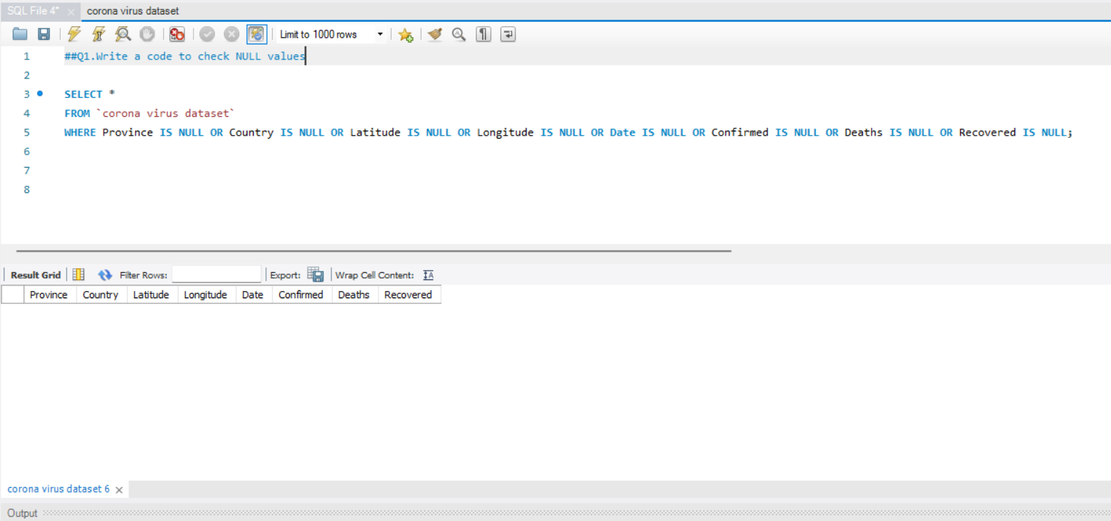
Q1:Write a code to check NULL values

Slide 7
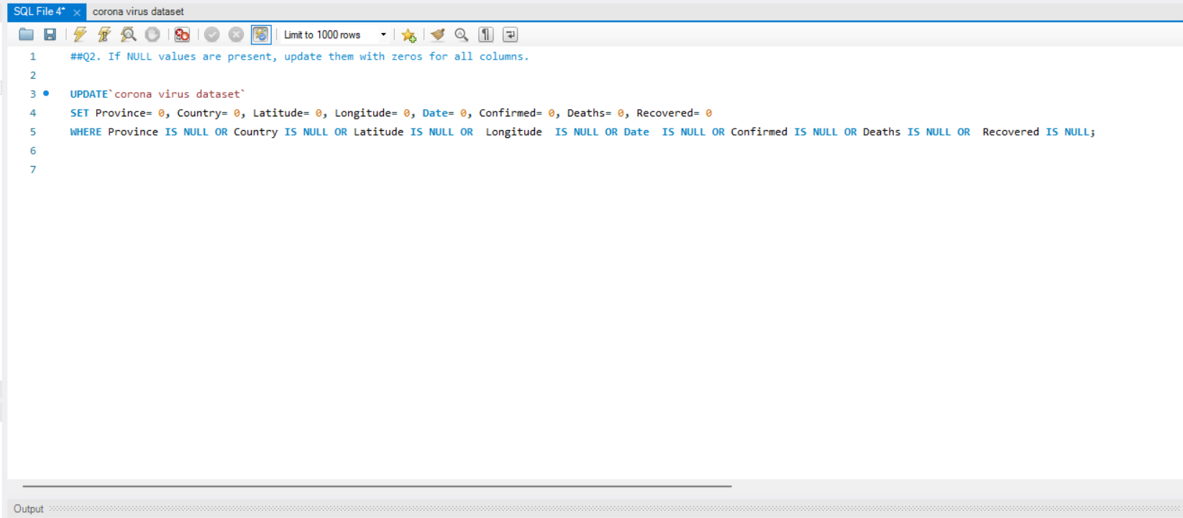
Q2:If NULL values are present, update them with zeros for all columns.

Slide 8
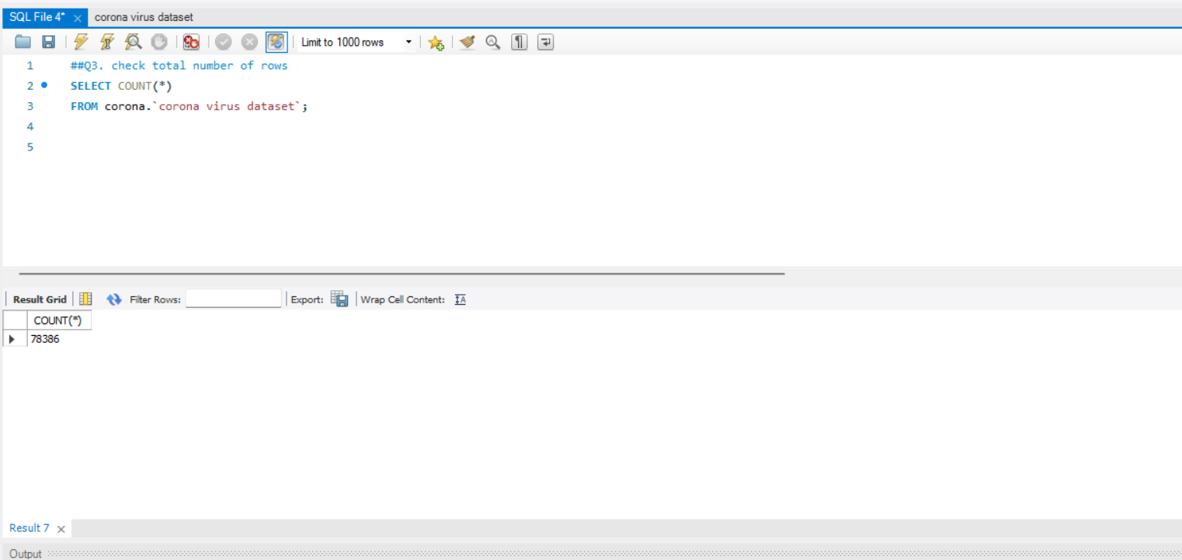
Q3. check total number of rows

Slide 9
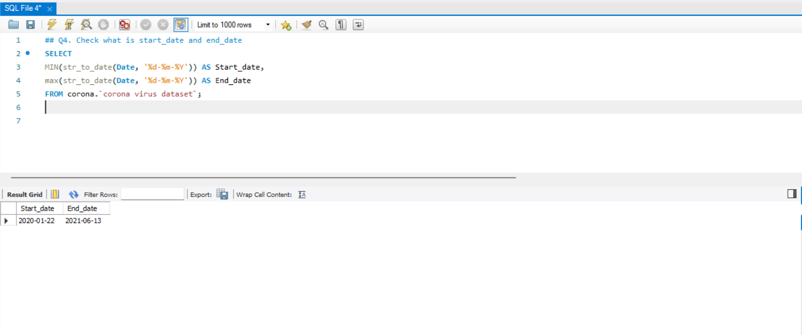
Q4. Check what is start_date and end_date

Slide 10
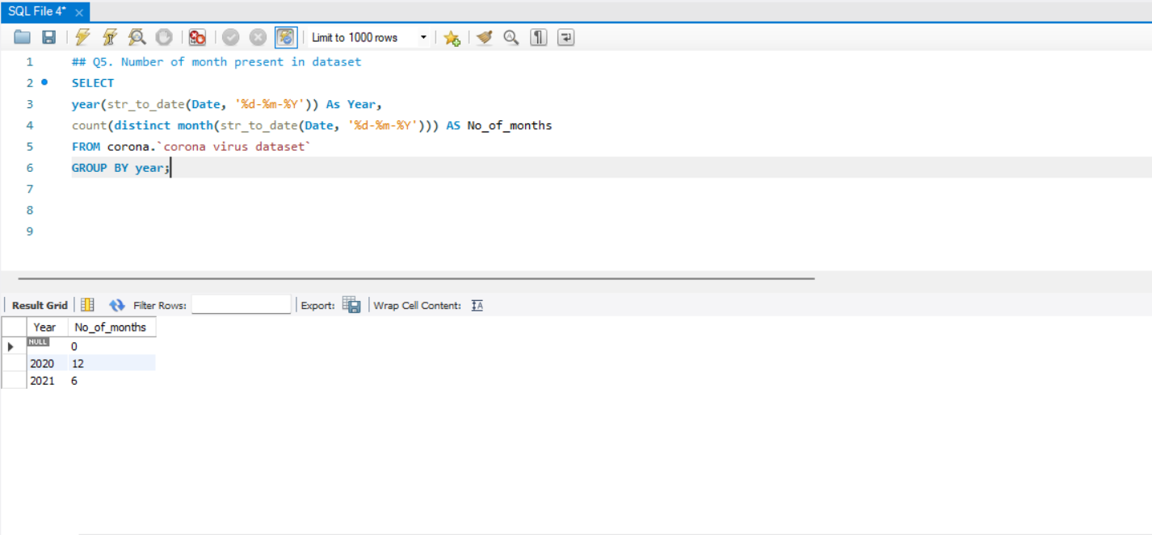
Q5. Number of month present in dataset

Slide 11
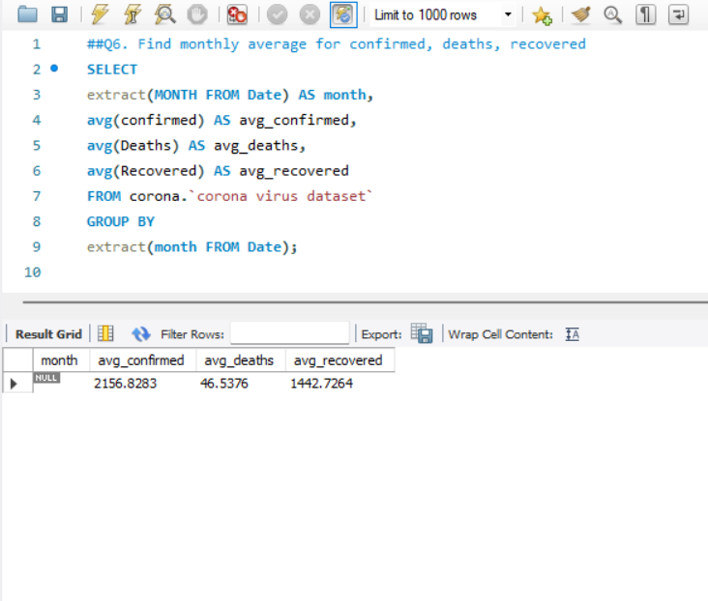
Q6. Find monthly average for confirmed, deaths, recovered

Slide 12
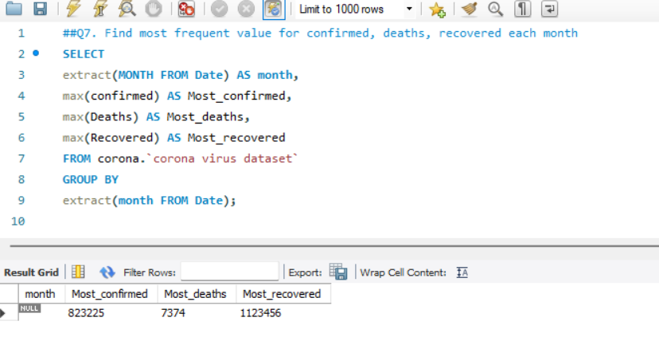
Q7. Find most frequent value for confirmed, deaths, recovered each month

Slide 13
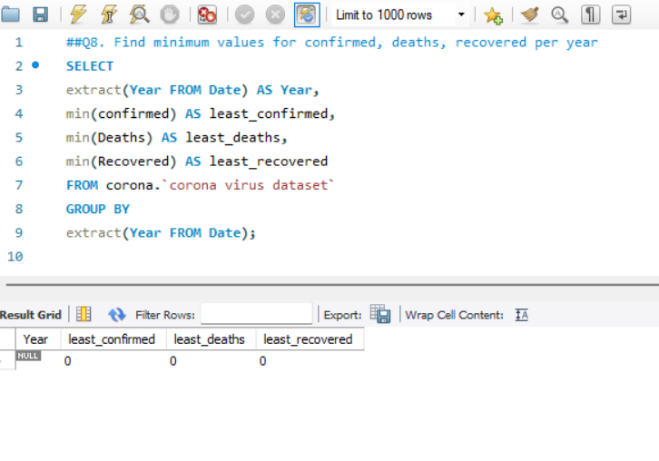
Q8. Find minimum values for confirmed, deaths, recovered per year

Slide 14
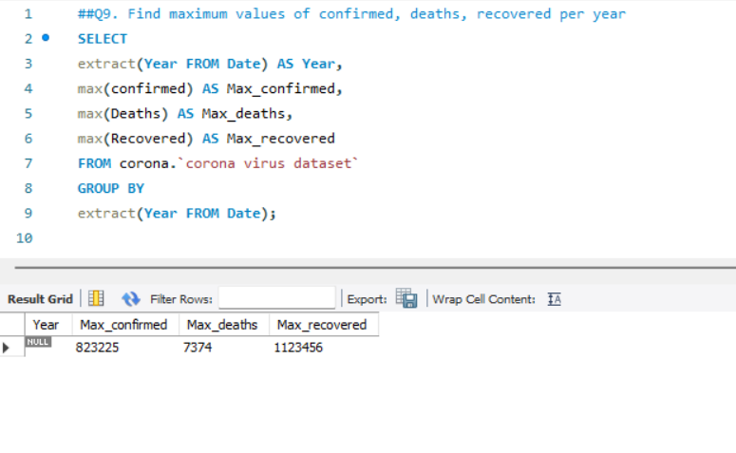
Q9. Find maximum values of confirmed, deaths, recovered per year

Slide 15
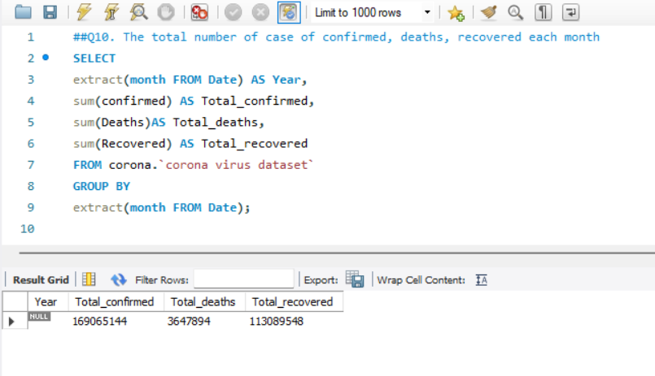
Q10. The total number of case of confirmed, deaths, recovered each month

Slide 16
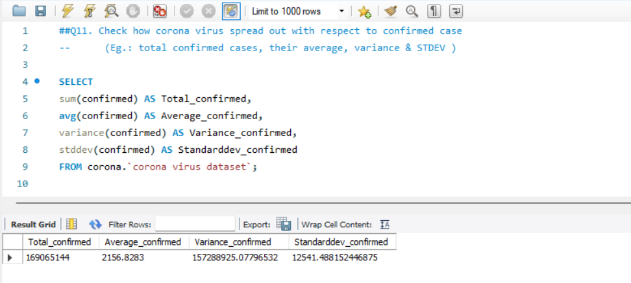
Q11. Check how corona virus spread out with respect to confirmed case (Eg: total confirmed cases, their average, variance & STDEV )

Slide 17
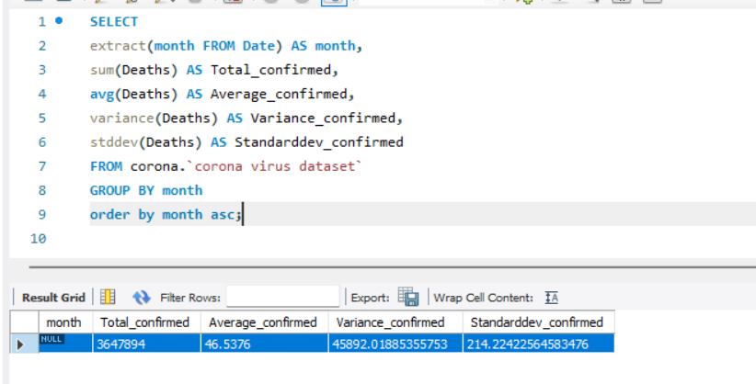
Q12. Check how corona virus spread out with respect to death case per month (Eg: total confirmed cases, their average, variance & STDEV )

Slide 18
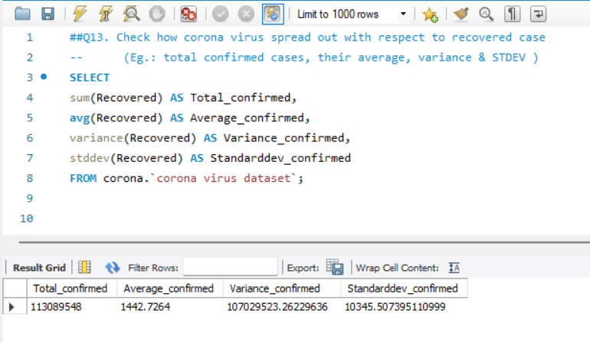
Q13. Check how corona virus spread out with respect to recovered case (Eg: total confirmed cases, their average, variance & STDEV )

Slide 19
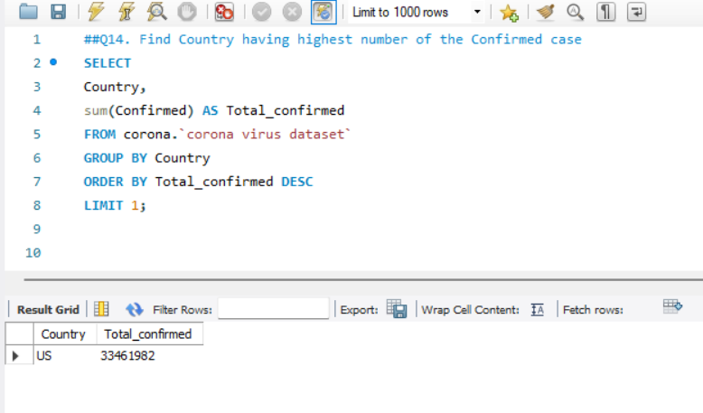
Q14. Find Country having highest number of the Confirmed case

Slide 20
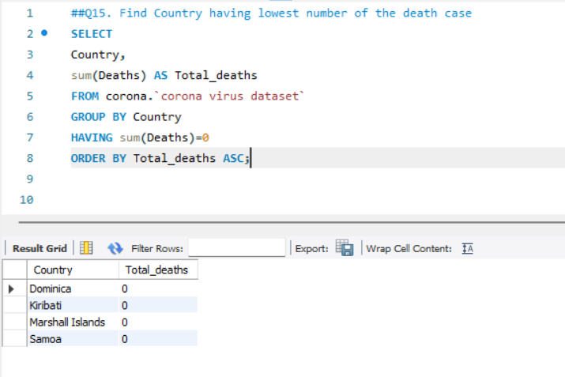
Q15. Find Country having lowest number of the death case

Slide 21
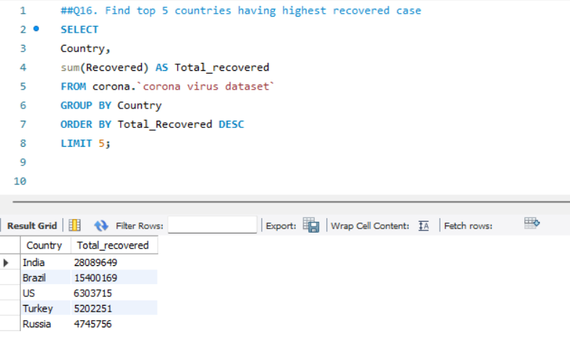
Q16. Find top 5 countries having highest recovered case

Slide 22

SUMMARY
This comprehensive analysis provides valuable insights into the progression and impact of the coronavirus pandemic, facilitating better understanding and informed decision-making for stakeholders involved in managing the crisis.

Slide 23
THANK YOU!!

